Slide 1
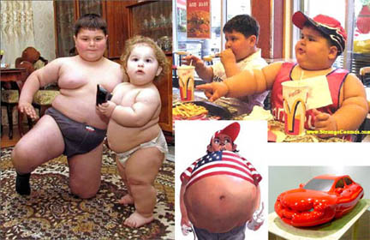
obesity

Slide 2
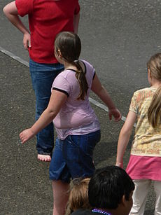
OBJECTIVES
-Definition; BMI; Causes of overweight in children and the role of genetics.
-Health side-effects that include serious diseases and psychological effect.
-Lines of management and prevention.

Slide 3
Case study A 7-year-old boy, presents to health child clinic because his parents are concerned about his weight . His parents state that his diet is generally good. His birth weight was 4 kg and his development is normal. He is on no medication. His general and systemic examination is normal .His height is125 cm (75th percentile) and weight is 38.7 kg (99th percentile).

Slide 4
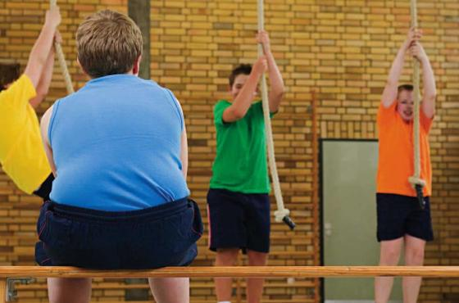
Overweight and obesity are defined as abnormal or excessive fat accumulation that presents a risk to health (WHO, 2010). Childhood obesity negatively affects a child's health or wellbeing.

Slide 5
The National Health and Nutrition Examination Survey (NHANES) indicates that the prevalence of obesity is increasing in all pediatric age groups, in both sexes, and in various ethnic and racial groups.

Slide 6
Causes Many factors, including genetics, environment, metabolism, lifestyle, and eating habits, are believed to play a role in the development of obesity. However, more than 90% of cases are idiopathic; less than 10% are associated with hormonal or genetic causes.

Slide 7
DIAGNOSIS:
Body mass index (BMI)
BMI = Weight in kg
(Height in m)2
-Obese children defined to have a BMI ≥ 95percentile
-Overweight children defined to have a BMI ≥ 85-<95 percentile(above 91 centile)

Slide 8
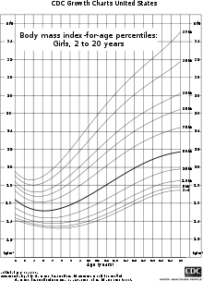
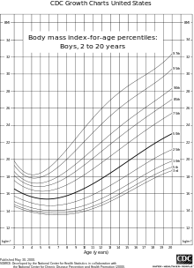

Slide 9
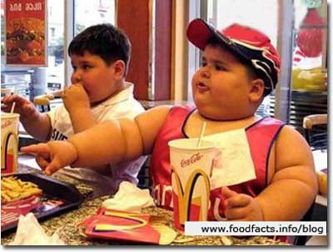
Causes
1- Dietary
Soft drink
fast food
“Breast-feeding “
may protect against obesity in later life with the duration of breast-feeding inversely associated with the risk of being overweight later on.

Slide 10
Sedentary lifestyle
Physical inactivity
Stationary activities such as playing video games or watching TV.
Technological activities are not the only household influences of childhood obesity.

Slide 11
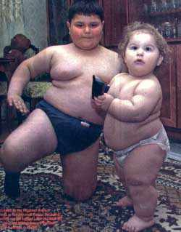
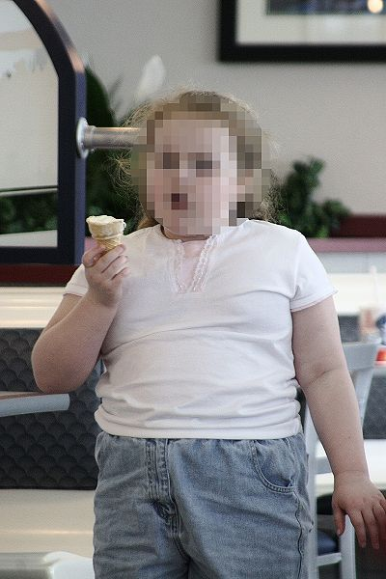

Slide 12
Genetics
Prader-Willi syndrome
poor linear growth, development delay, dysmorphic facial features ,hypotonia and un descended testis
Cushing's syndrome
Hypothyroidism

Slide 13
Medications : Cortisol and other glucocorticoids Sulfonylureas Tricyclic antidepressants (TCAs) Monoamine oxidase inhibitors (MAOIs), such as phenelzine

Slide 14
Home environment
Children's food choices are also influenced by family meals.

Slide 15
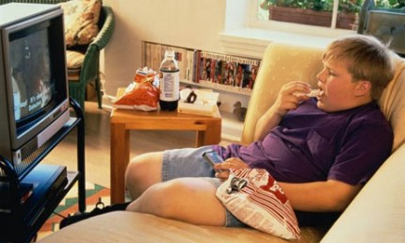
Signs and symptoms · Feeling of tight clothes · Excessive weight gain · Shortness of breath · High blood and cholesterol levels · Heartburn

Slide 16
Complications
1.Orthopedic
Slipped femoral epiphysis, Tibia vara, abnormal foot structure
2.Hypertension
3.Hypoventilation syndrome
3.Gall bladder diseases
4.Polycystic ovary
5.Hyper insulinaemia
5.Abnormal blood lipid
6.Other , asthma
7.Psychological sequelae ;low self-esteem, teasing, depression, body dissatisfaction

Slide 17
Evaluation 1)growth chart for weight, height, and BMI 2) medical causes of obesity 3) family eating habits, nutritional, and activity patterns 4) Complete pediatric history 5) Family history 6) Physical examination 7)Laboratory testing

Slide 18
MESSEGE TO PARENTS AND PATIENTS:
- An imbalance between energy consumption and energy expenditure.
Obese children need high energy
An obese child tends to become an obese adult
No any drug is effective in treating childhood obesity
Obesity may be prevented and treated by: Increasing physical activity
A medical cause of obesity is more likely in the child who is obese and short.
Most children are not obese because of medical cause, but as a result of their lifestyle.

Slide 19
Management
Lifestyle
Exclusive breast-feeding is recommended in all newborn infants
Medications
There are no medications currently approved for the treatment of obesity in children.
Orlistat a pancreatic lipase inhibitor, is approved for long-term obesity management in adult patients in the United States
sibutramine may however be helpful in managing moderate obesity in adolescence.

Slide 20
Thanks

